Slide 1

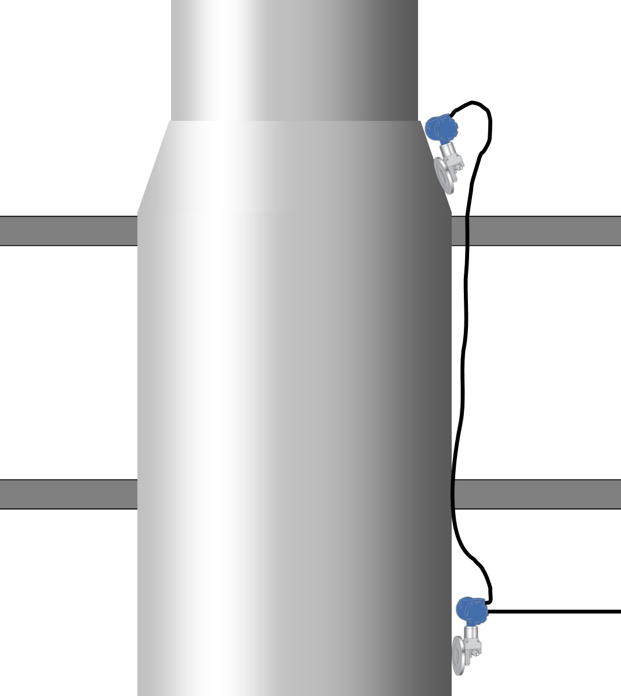

Iogen in Ottawa installs their first ERS solution in record time allowing accurate level measurement in a tall vessel
CHALLENGE
Iogen required a level measurement on a tall, narrow, unevenly shaped tank which spanned two storeys in the plant. Because of the geometry of the tank, it was decided that a bottom-up technology had be used. Typically, a balanced remote seal system would be installed on the intermediate floor with capillaries and tri-clamp seals going to each adjacent floor. This required a complex installation as the sensors are connected by a relatively fragile capillary that must be passed through narrow openings in the two floors. The capillary is sensitive to bending and requires careful handling. Complex calculations are also normally required to offset the head pressure of the capillary and the transmitter mounting position effect.
SOLUTION
Laurentide proposed the new Rosemount ERS system for improved accuracy and simplified installation and commissioning.
RESULTS
The system was mechanically installed in record time. The upper Tx was installed at a 45 deg angle. Correcting for position effect was done in less than one minute. The bottom Tx was zeroed and although the DP was only validated, there was no need for correction as the system showed true zero. The whole commissioning took less than 10 minutes.
“It meets all of our expectations… we’ve been waiting for this for years!”

